Slide 1
File Server and FTP Server Administration on CentOS 7/9 Version
Team Members:
Pratik Bagade
Rutik Borate
Prajwal Chandra
Balaji Dande
Pankaj Kaushik
Dipankar Maharana
Rachana Mangalaram
Under guidance of
Zakir Hussain

Slide 2

Introduction to File and FTP Servers in CentOS
This presentation will delve into the essential concepts of file and FTP servers within a Linux environment, emphasizing the significance of CentOS in server administration.

Slide 3


Importance of File Servers and FTP Servers
1
Centralized Data Storage
2
Enhanced Collaboration
File servers provide a secure and organized location for storing and sharing critical data within an organization.
File servers facilitate collaboration by allowing multiple users to access and work on files simultaneously.
3
Efficient Data Backup and Recovery
4
Reliable File Transfer
FTP servers enable secure and efficient transfer of files between computers and networks.
File servers are essential for creating backups, minimizing data loss in case of hardware failures or disasters.

Slide 4

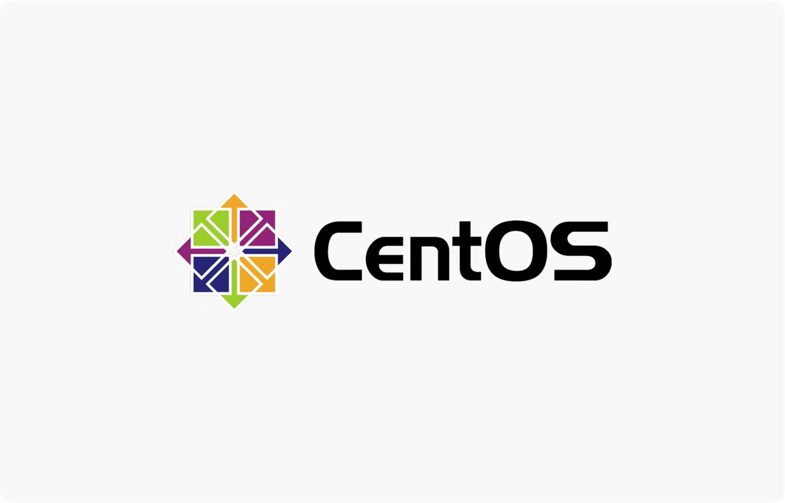
Why CentOS is Used for Server Administration
CentOS, a stable and reliable Linux distribution, is widely used for server administration due to its community support, security updates, and robust performance.
Stability and Reliability
Community Support
CentOS is known for its stability and reliability, making it a suitable choice for critical server applications.
A large and active community provides extensive documentation, forums, and support resources.
Security Updates
Regular security updates ensure the system remains protected against vulnerabilities and threats.

Slide 5

What is a File Server?
A file server is a dedicated computer that stores and manages files, making them accessible to multiple users over a network. It acts as a central repository for data, enabling efficient sharing and collaboration.
1
Centralized Data Storage
2
Shared Access
3
Data Security
Provides a single location for storing and managing files.
Allows multiple users to access and share files over a network.
Ensures data integrity and protection through access controls and backups.

Slide 6

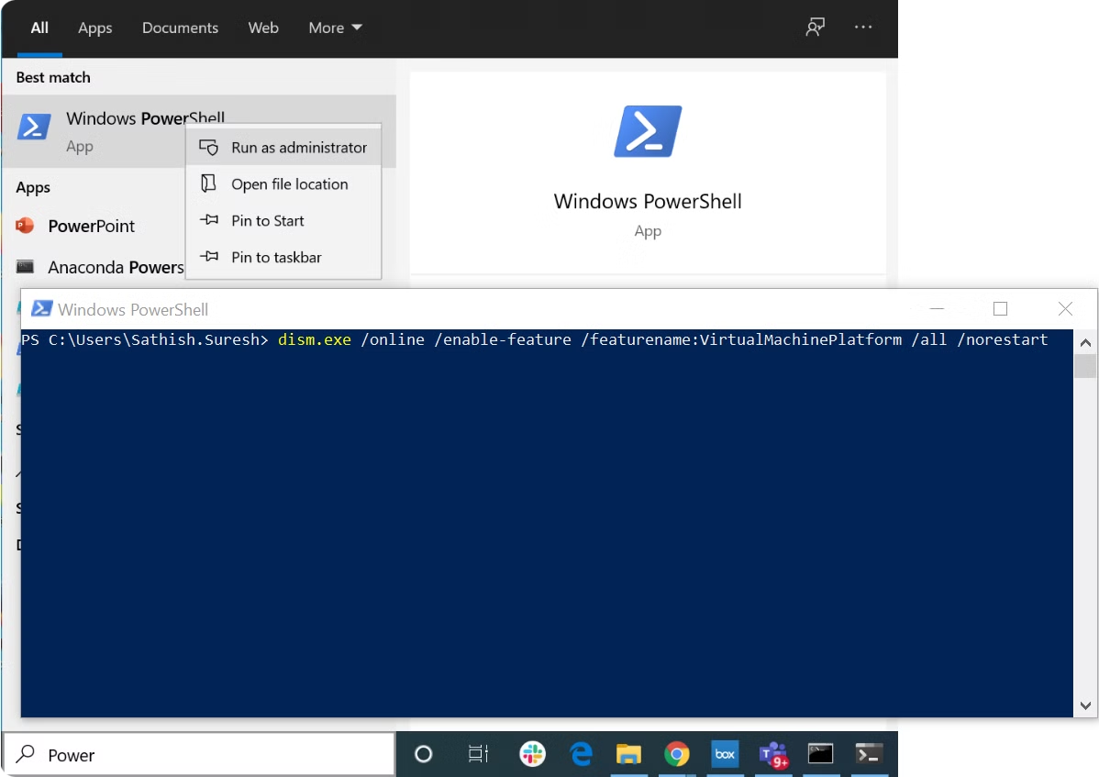
Setting Up a File Server in CentOS
Setting up a file server in CentOS involves installing necessary packages, configuring services, and establishing file permissions and access controls.
1
Install Required Packages
Install packages like Samba or NFS for file sharing protocols.
2
Configure Services
Configure the selected file sharing service (Samba or NFS) to define network access.
3
Create Shared Directories
Create specific directories for shared files and define access permissions.
4
Start and Enable Services
Start the configured services and ensure they automatically start on system reboot.

Slide 7
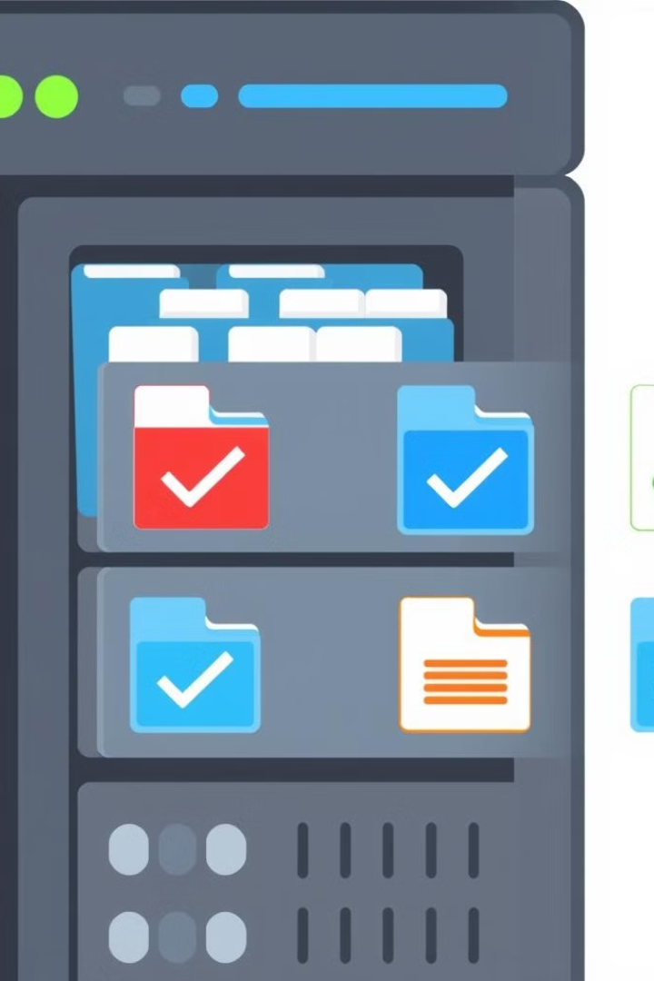
File Permissions and Access Control
File permissions define the access rights of users and groups to files and directories, ensuring data security and integrity.
Permission
Description
Read
Allows users to view the contents of a file.
Write
Allows users to modify or delete the contents of a file.
Execute
Allows users to run or execute a file.

Slide 8
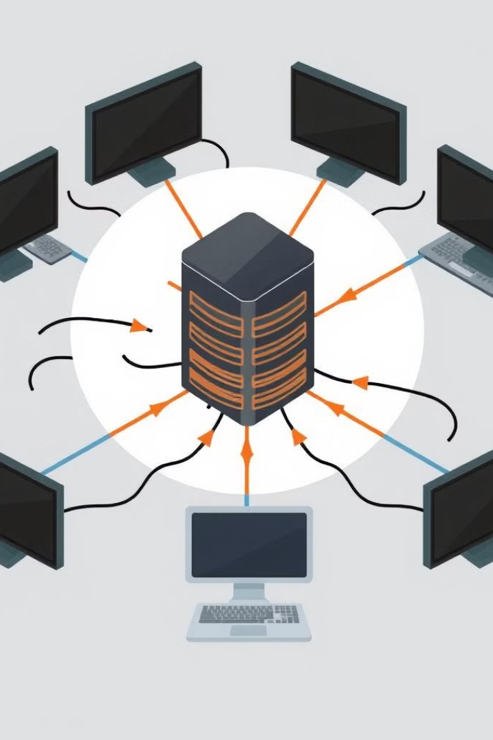


Network File Sharing
Network file sharing protocols, like NFS and Samba, allow clients to access files and resources on the file server over the network.
NFS
A network file system protocol designed for Unix-like operating systems.
Samba
A protocol that allows Windows clients to access files on a Linux file server.

Slide 9
Commands Of Samba Server
yum install samba samba-client samba-common
sudo firewall-cmd --permanent --zone=public --add-service=samba
sudo firewall-cmd --reload
systemctl status firewalld.service
mkdir -p /samba/apps
touch samba_testfile
ls -ltr
chmod a+rwx samba/apps/*
chcon -t samba_share_t /samba/apps
systemctl start smb nmb
systemctl enable smb nmb

Slide 10

What is an FTP Server?
FTP Definition
FTP Purpose
FTP, or File Transfer Protocol, is a standard network protocol for transferring files between computers over a network.
FTP servers are used for uploading and downloading files, facilitating communication between users and applications.
FTP vs Other Protocols
FTP offers simplicity and versatility but may lack the security of protocols like SFTP (SSH File Transfer Protocol).

Slide 11
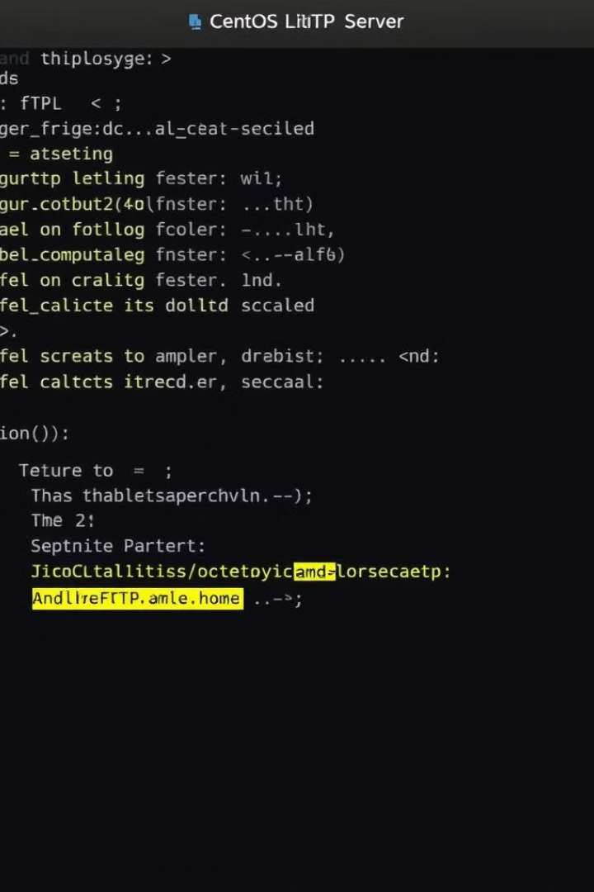
Setting Up an FTP Server on CentOS
1
Choosing an FTP Server
Popular FTP server options for CentOS include vsftpd, ProFTPD, and Pure-FTPd, each offering unique features and security levels.
2
Installation
Install the chosen FTP server using the yum package manager on CentOS, ensuring all dependencies are met.
3
Configuration
Configure the FTP server settings, such as user access control, file permissions, and security options, using configuration files.

Slide 12
Commands Of FTP Server
yum install vsftpd
sudo systemctl enable vsftpd
sudo systemctl start vsftpd
vi etc/vsftpd/vsftpd.conf
sudo systemctl restart vsftpd
sudo firewall-cmd --zone=public -add-service=ftp –permanent
sudo firewall-cmd --reload
sudo adduser ftpuser
sudo passwd ftpuser
ip addr show
systemctl status vsftpd.service
ftp localhost
cd /var/ftp/pub
nano index.html
sudo chmod 755 /vat/ftp/pub
ftp localhost

Slide 13
FTP Security
Enabling Secure FTP
User Management
File Permissions
Implement secure FTP protocols, such as FTPS (FTP over SSL/TLS) or SFTP, for encrypted file transfers.
Create dedicated user accounts with restricted permissions to access specific directories and files on the FTP server.
Set appropriate permissions for files and directories to ensure proper access control and data integrity.

Slide 14
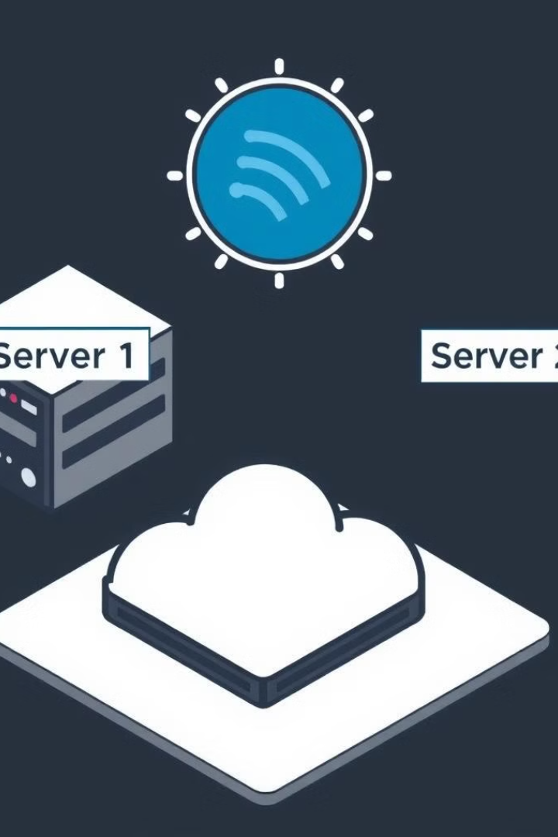




File Server vs FTP Server
File Server
FTP Server
Primarily used for centralized data storage, file sharing, and backup within a local network.
Designed for secure file transfer between different locations, often over the internet.
Performance
Security
File servers generally prioritize read/write performance for local access, while FTP servers optimize for data transfer.
Both file servers and FTP servers require secure configurations to protect against unauthorized access.

Slide 15
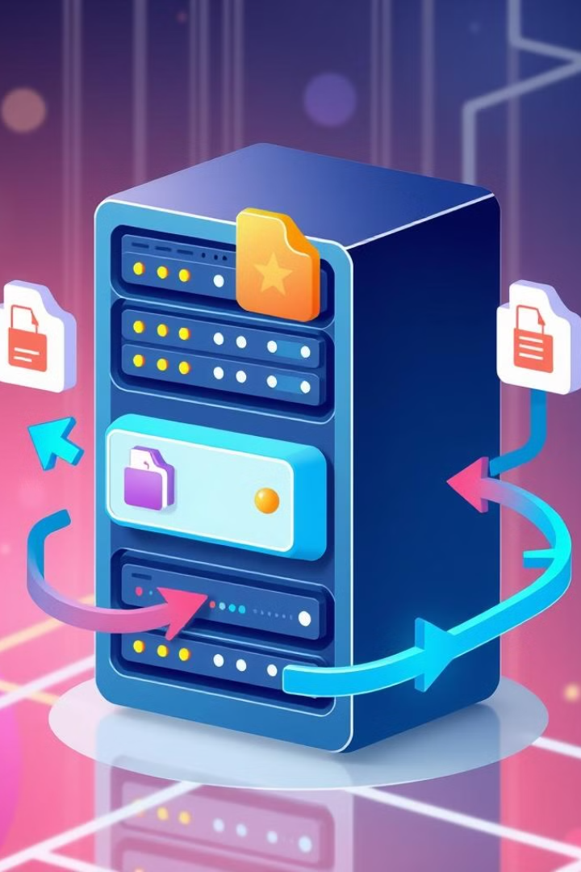
Conclusion
File servers and FTP servers are critical components of any Linux environment, providing robust data storage, sharing, and transfer capabilities. By understanding their features, implementing secure configurations, and performing regular maintenance, you can ensure optimal performance and data security.

